Slide 1
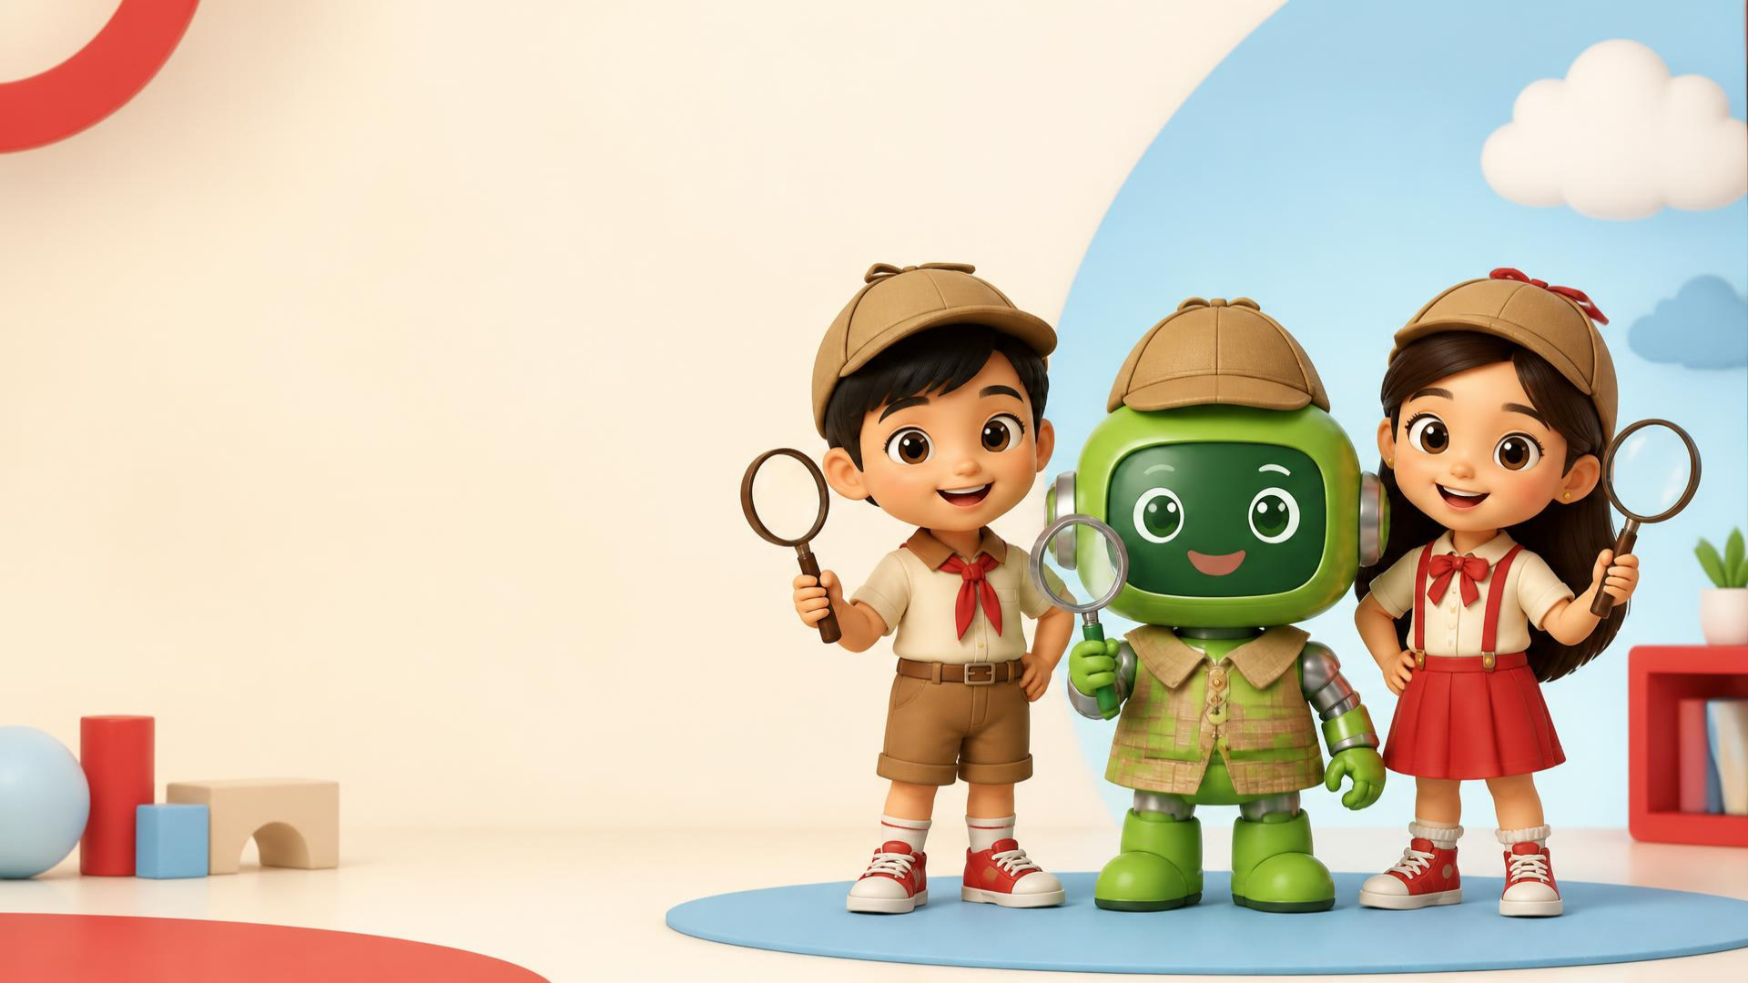

1 / 13
LESSON 5 - RED HUNT AND WEEK 1 REVIEW
It’s Review Time!
Let’s remember what we learned!
LITTLE SEEDS! MONTH 1

Slide 2
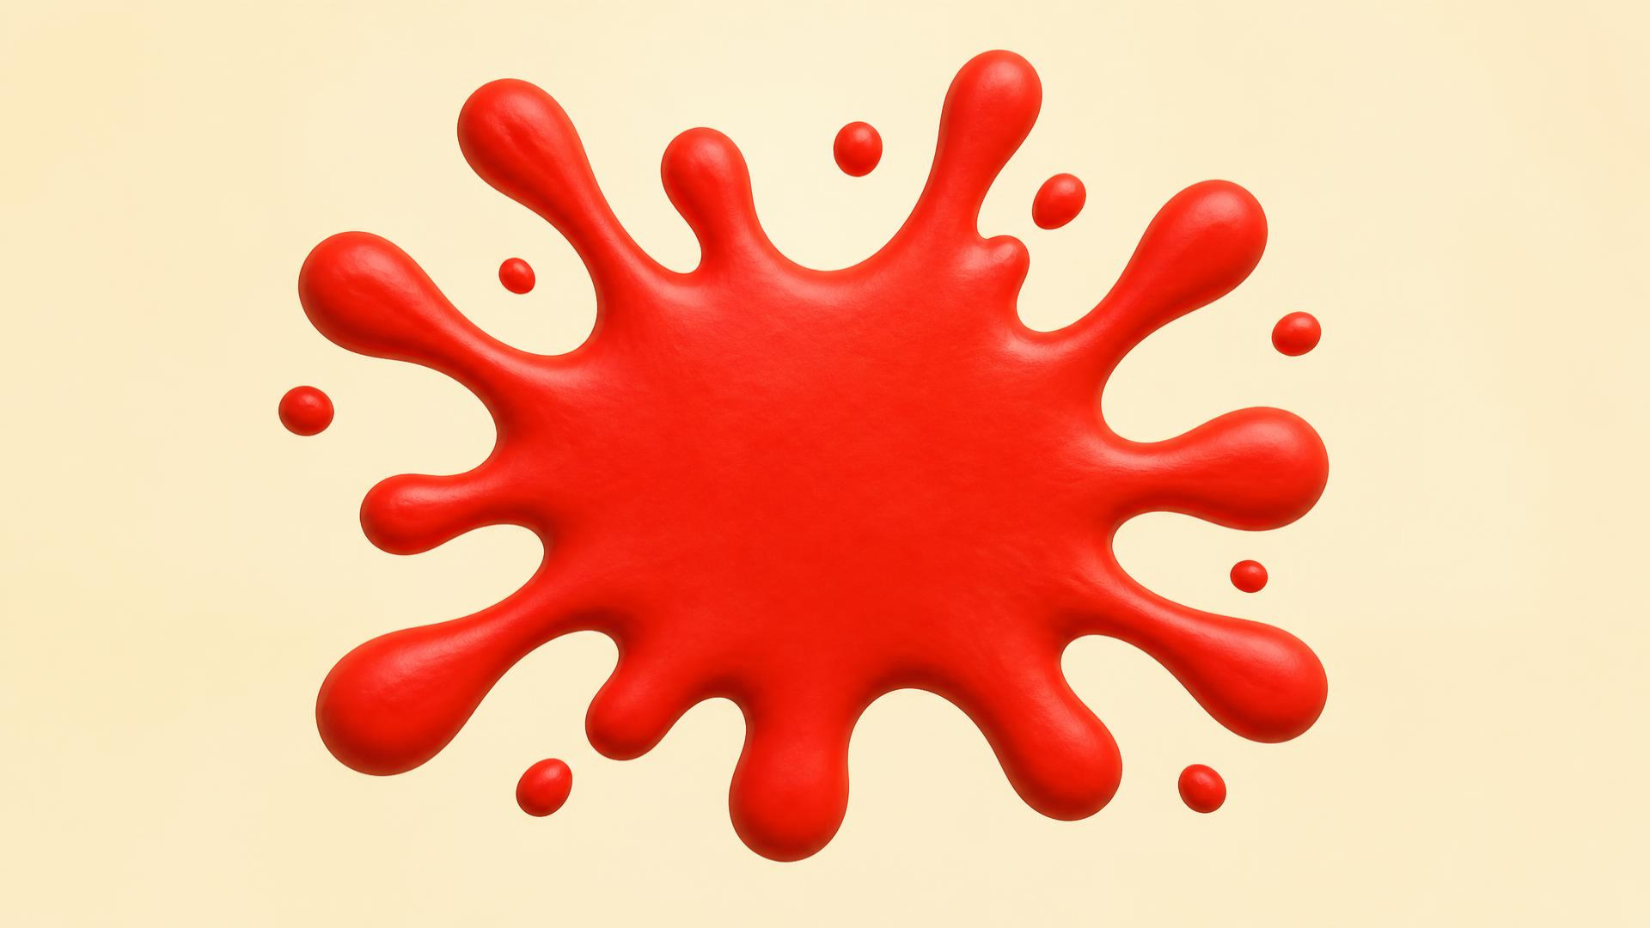
LESSON 5 - RED HUNT AND WEEK 1 REVIEW
2 / 13
Red.
Look. Point. Say: RED!
LITTLE SEEDS! MONTH 1

Slide 3
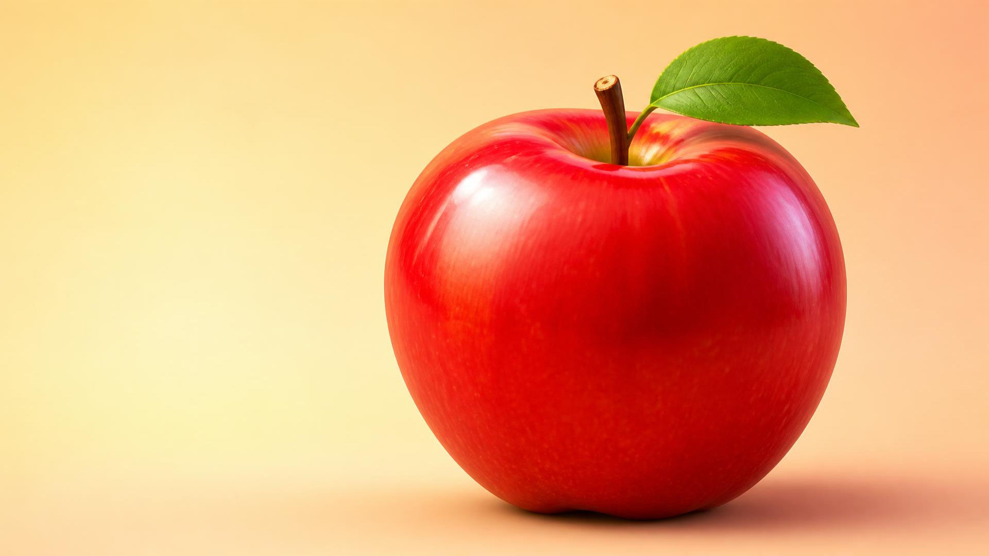
3 / 13
LESSON 5 - RED HUNT AND WEEK 1 REVIEW
Apple.
A red apple. Say: APPLE!
LITTLE SEEDS! MONTH 1

Slide 4

4 / 13
LESSON 5 - RED HUNT AND WEEK 1 REVIEW
Sun.
A bright sun. Say: SUN!
LITTLE SEEDS! MONTH 1

Slide 5
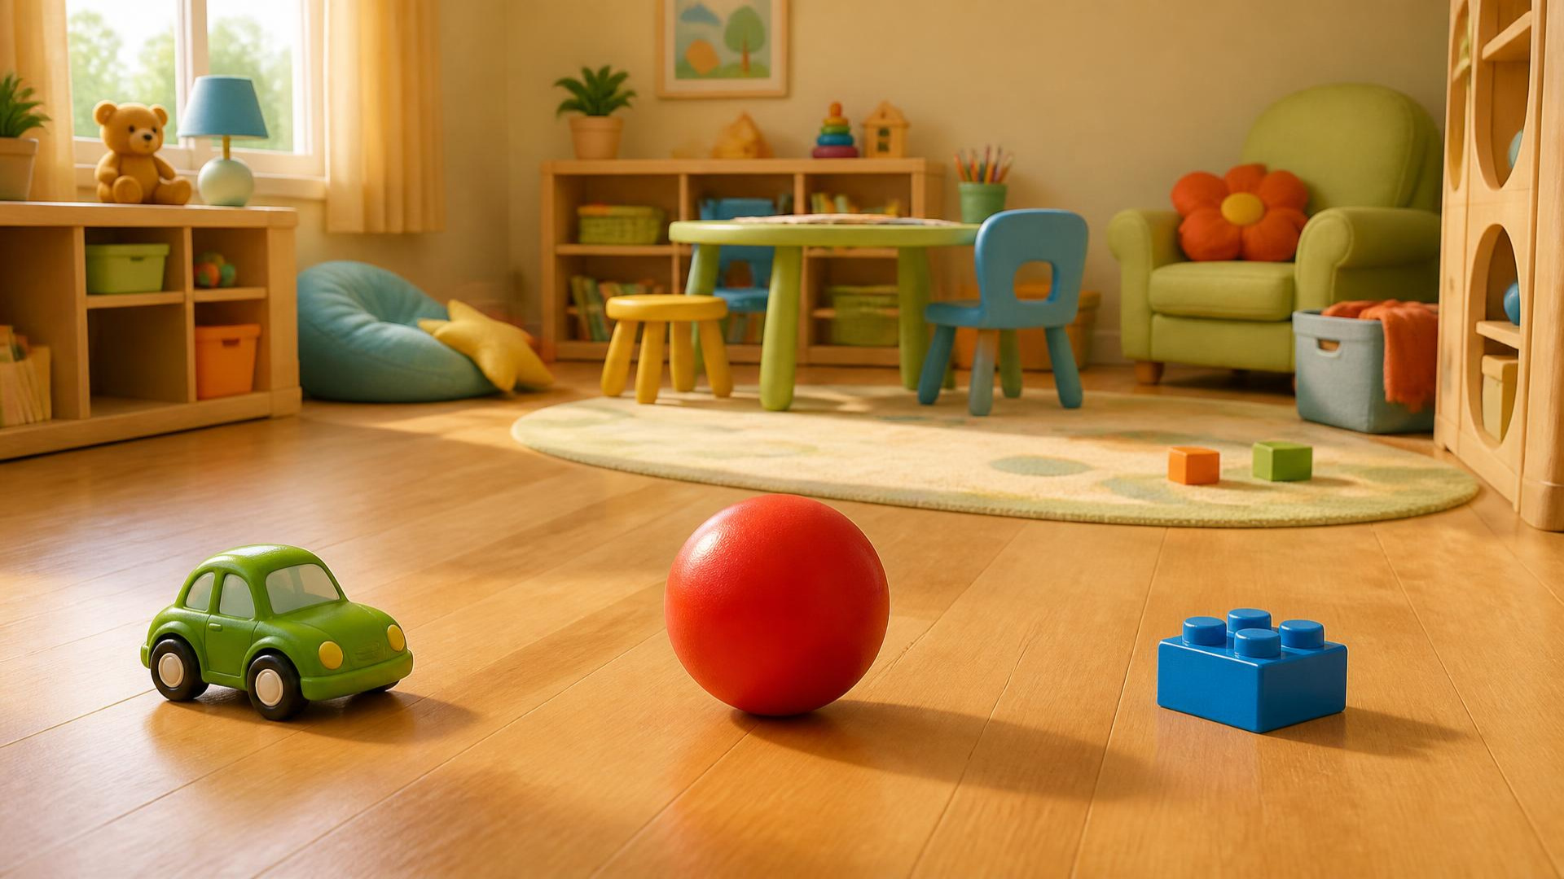
LESSON 5 - RED HUNT AND WEEK 1 REVIEW
5 / 13
Find Red!
Can you touch the red toy?
LITTLE SEEDS! MONTH 1

Slide 6
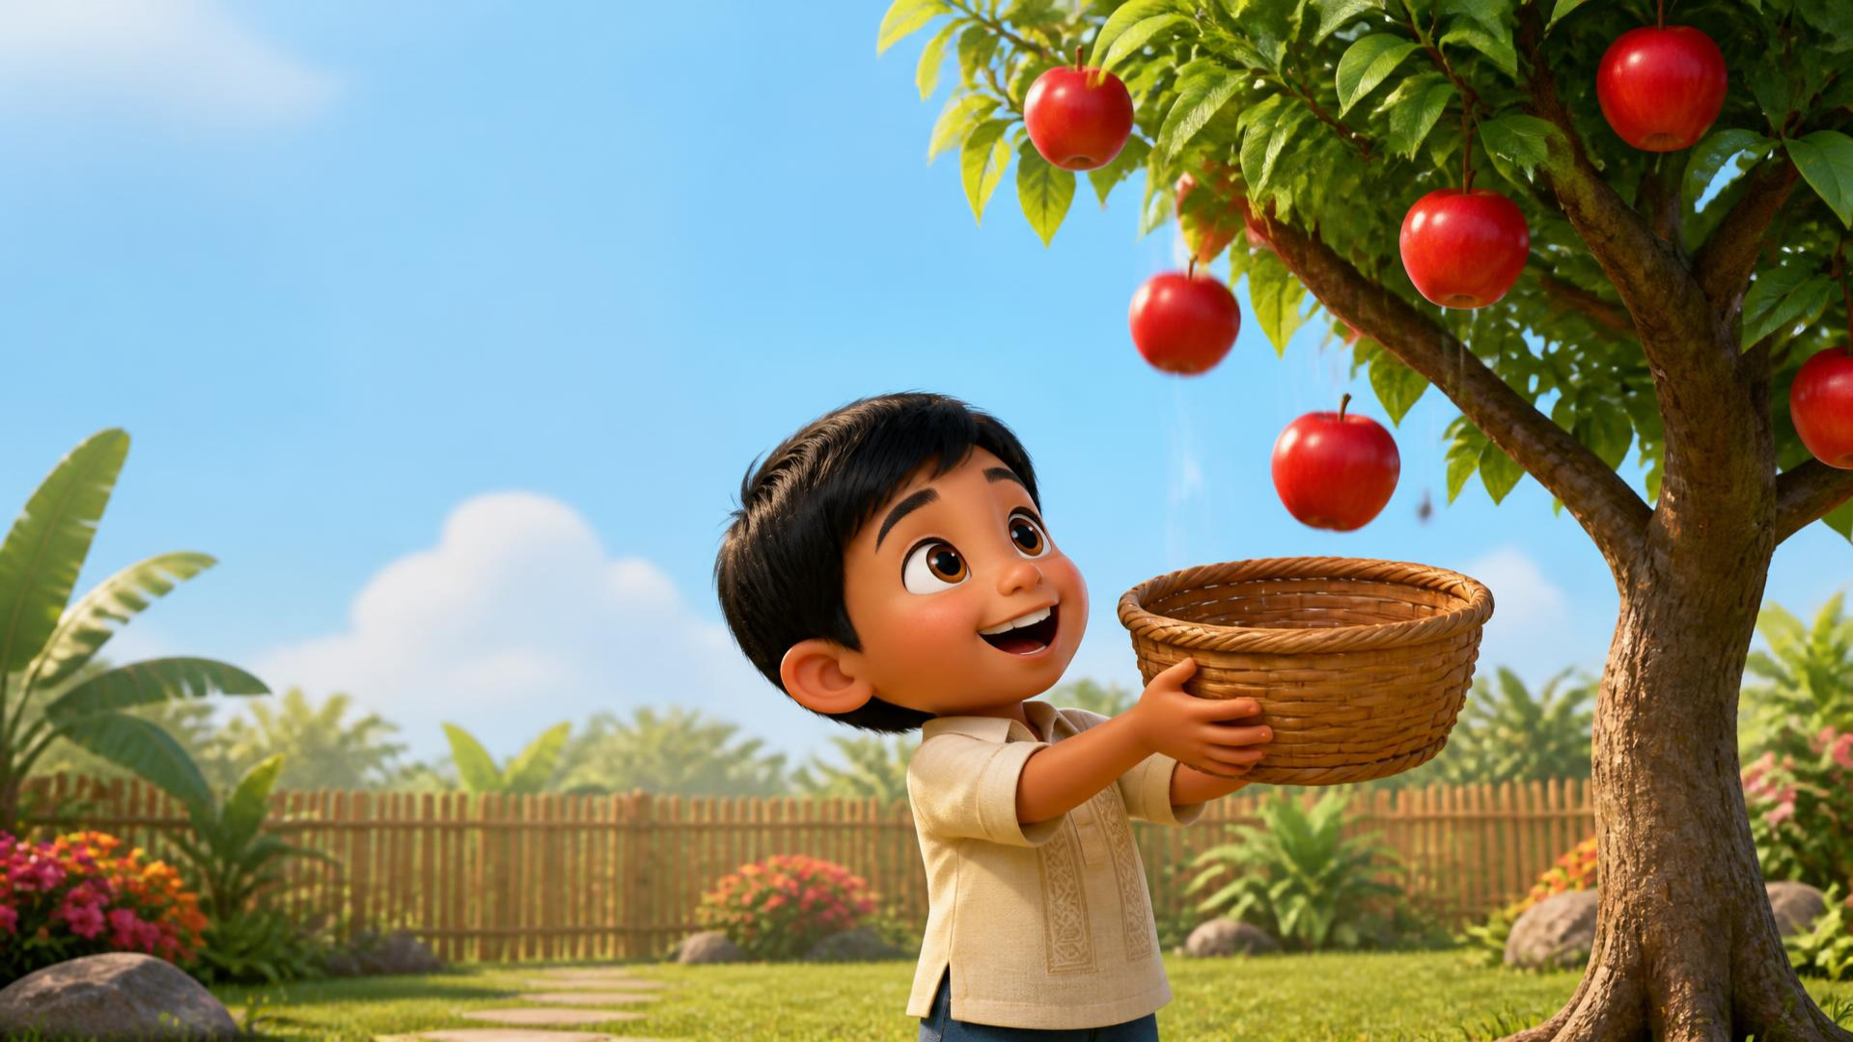
LESSON 5 - RED HUNT AND WEEK 1 REVIEW
6 / 13
Catch the apple!
Pretend to catch it in your basket!
LITTLE SEEDS! MONTH 1

Slide 7
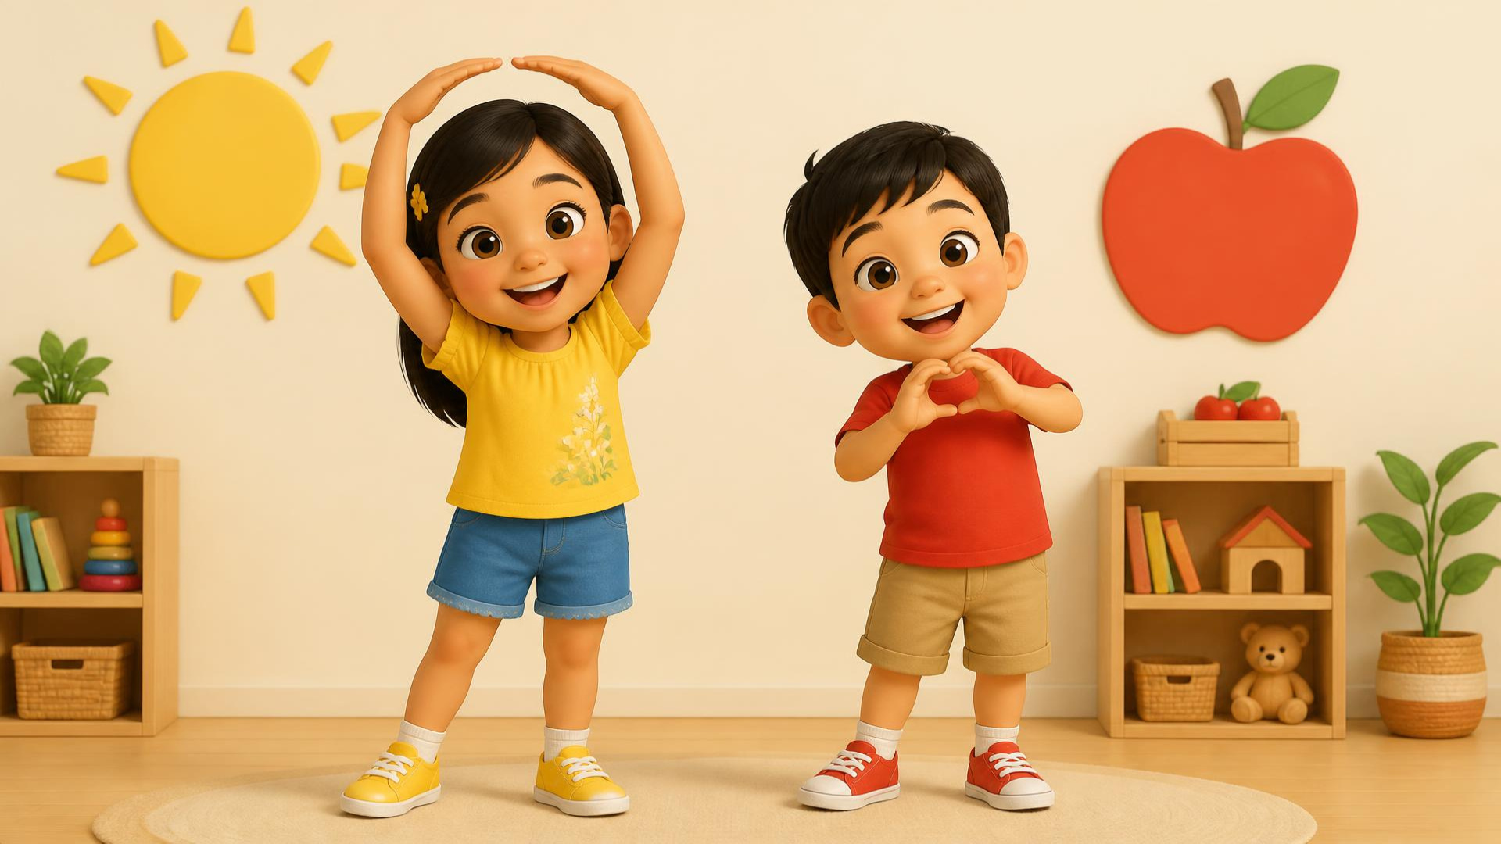
LESSON 5 - RED HUNT AND WEEK 1 REVIEW
7 / 13
Big and Small.
Make a BIG sun. Make a small apple.
LITTLE SEEDS! MONTH 1

Slide 8
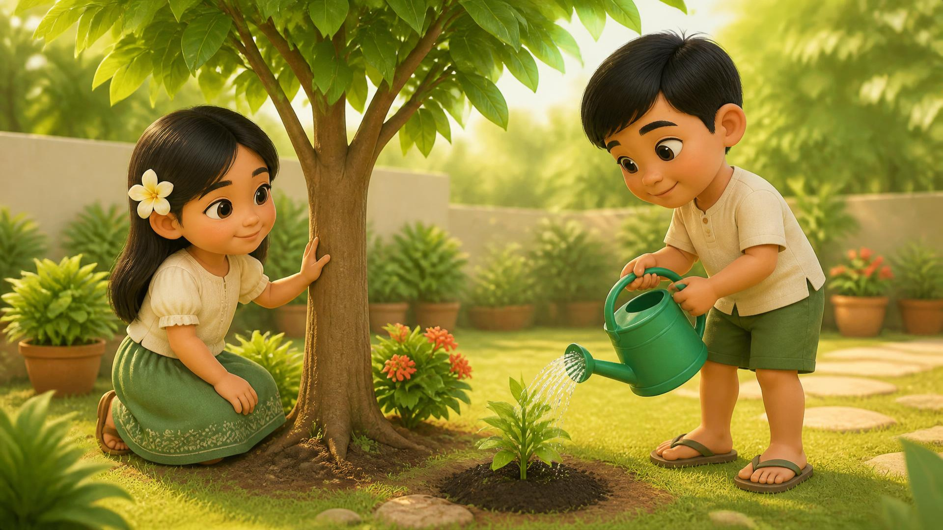
LESSON 5 - RED HUNT AND WEEK 1 REVIEW
8 / 13
Gentle hands.
We care for plants and trees.
LITTLE SEEDS! MONTH 1

Slide 9

LESSON 5 - RED HUNT AND WEEK 1 REVIEW
9 / 13
God made our world.
Thank you, God, for colors and light.
LITTLE SEEDS! MONTH 1

Slide 10
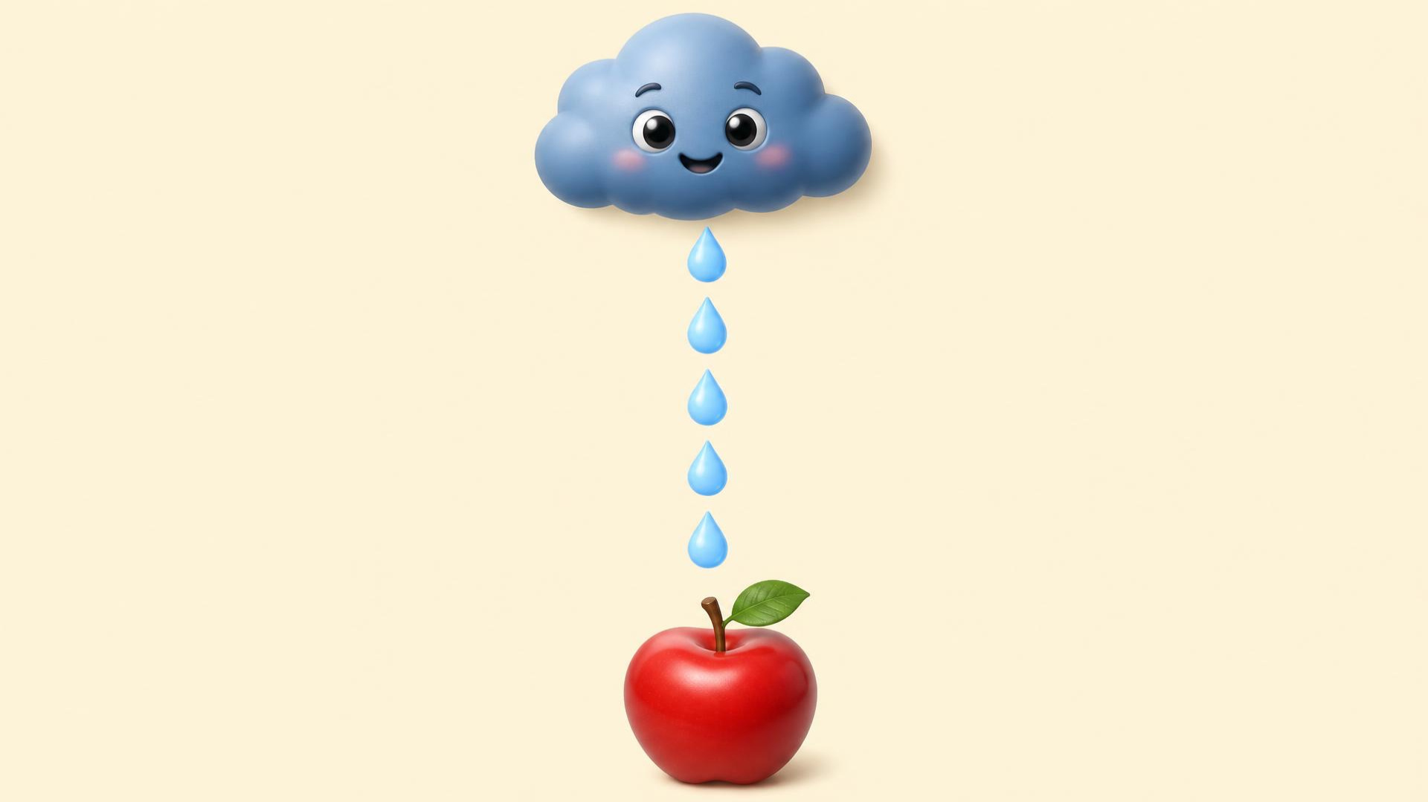
LESSON 5 - RED HUNT AND WEEK 1 REVIEW
10 / 13
Draw down.
Trace from the cloud to the apple.
LITTLE SEEDS! MONTH 1

Slide 11

LESSON 5 - RED HUNT AND WEEK 1 REVIEW
11 / 13
Your turn! Find red!
Look around. Show us something red!
LITTLE SEEDS! MONTH 1

Slide 12

LESSON 5 - RED HUNT AND WEEK 1 REVIEW
12 / 13
You did it!
Say it together: APPLE • SUN • RAIN
LITTLE SEEDS! MONTH 1

Slide 13
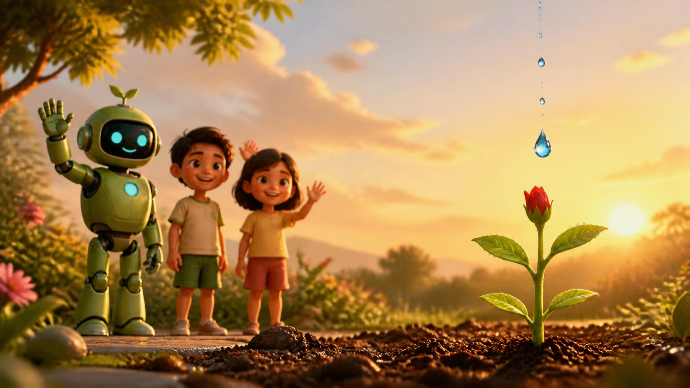
LESSON 5 - RED HUNT AND WEEK 1 REVIEW
13 / 13
Goodbye!
You earned 5 Eco-Drops for your garden!
Thank you for caring for our earth.
LITTLE SEEDS! MONTH 1

